Slide 1
Clustering in Machine Learning
Clustering or cluster analysis is a machine learning technique, which groups the unlabelled dataset.
It can be defined as "A way of grouping the data points into different clusters, consisting of similar data points. The objects with the possible similarities remain in a group that has less or no similarities with another group.“
It does it by finding some similar patterns in the unlabelled dataset such as shape, size, color, behavior, etc., and divides them as per the presence and absence of those similar patterns.
It is an unsupervised learning method, hence no supervision is provided to the algorithm, and it deals with the unlabeled dataset.
After applying this clustering technique, each cluster or group is provided with a cluster-ID. ML system can use this id to simplify the processing of large and complex datasets.
The Aims to group data sample into different groups based on their similarties

Slide 2
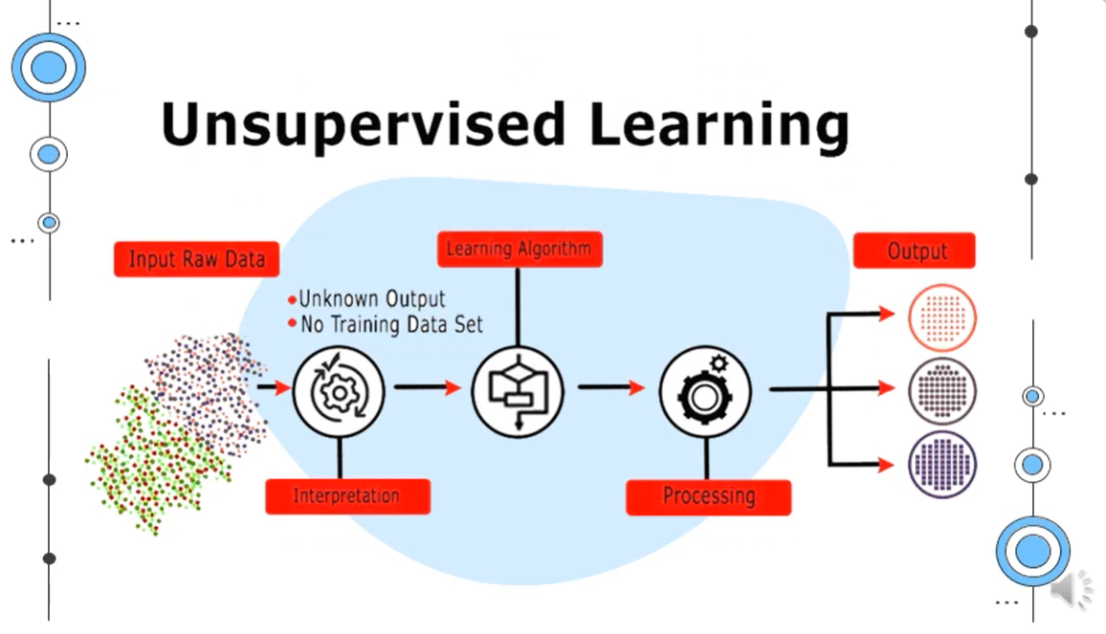

Slide 3
Example
Let's understand the clustering technique with the real-world example of Mall:
When we visit any shopping mall, we can observe that the things with similar usage are grouped together. Such as the t-shirts are grouped in one section, and trousers are at other sections, similarly, at vegetable sections, apples, bananas, mangoes, etc., are grouped in separate sections, so that we can easily find out the things. The clustering technique also works in the same way. Other examples of clustering are grouping documents according to the topic.
Some most common uses of this technique are:
Market Segmentation
Statistical data analysis
Social network analysis
Image segmentation
Anomaly detection, etc.

Slide 4
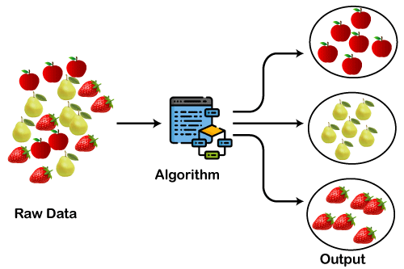
Diagram explains the working of the clustering algorithm

Slide 5
K-Means Clustering Algorithm
K-Means Clustering is an Unsupervised Learning algorithm, which groups the unlabeled dataset into different clusters. Here K defines the number of pre-defined clusters that need to be created in the process, as if K=2, there will be two clusters, and for K=3, there will be three clusters, and so on.
It allows us to cluster the data into different groups and a convenient way to discover the categories of groups in the unlabeled dataset on its own without the need for any training.
The k-means clustering algorithm mainly performs two tasks:
Determines the best value for K center points or centroids by an iterative process.
Assigns each data point to its closest k-center. Those data points which are near to the particular k-center, create a cluster.

Slide 6
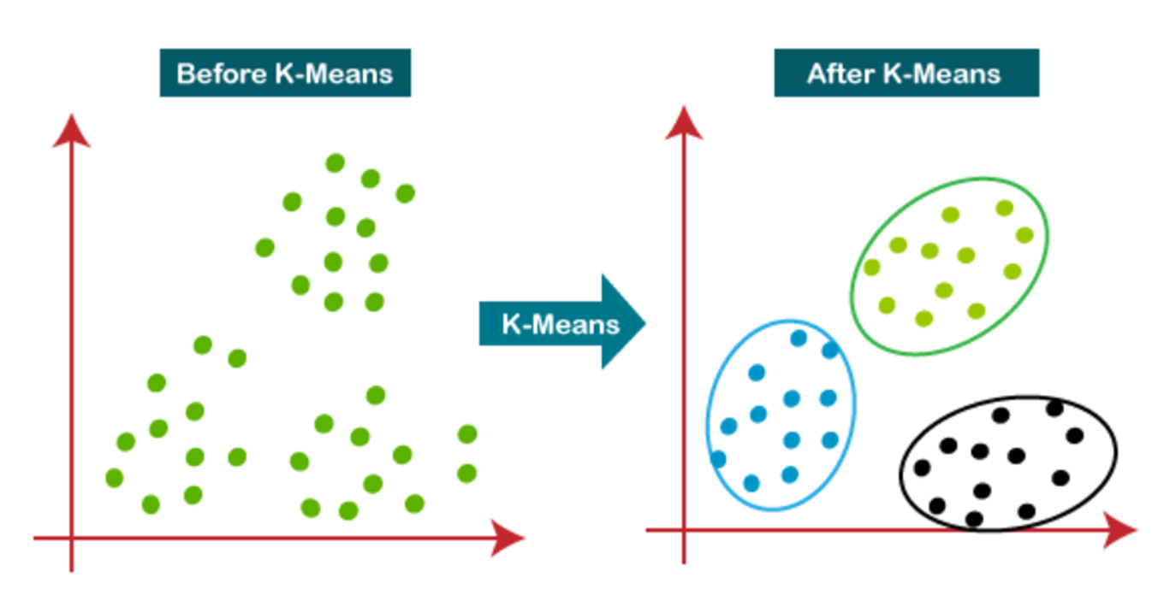
Diagram explains the working of the K-means Clustering Algorithm

Slide 7
How does the K-Means Algorithm Work?
Step-1: Select the number K to decide the number of clusters.
Step-2: Select random K points or centroids. (It can be other from the input dataset).
Step-3: Assign each data point to their closest centroid, which will form the predefined K clusters.
Step-4: Calculate the variance and place a new centroid of each cluster.
Step-5: Repeat the third steps, which means reassign each datapoint to the new closest centroid of each cluster.
Step-6: If any reassignment occurs, then go to step-4 else go to FINISH.
Step-7: The model is ready.

Slide 8
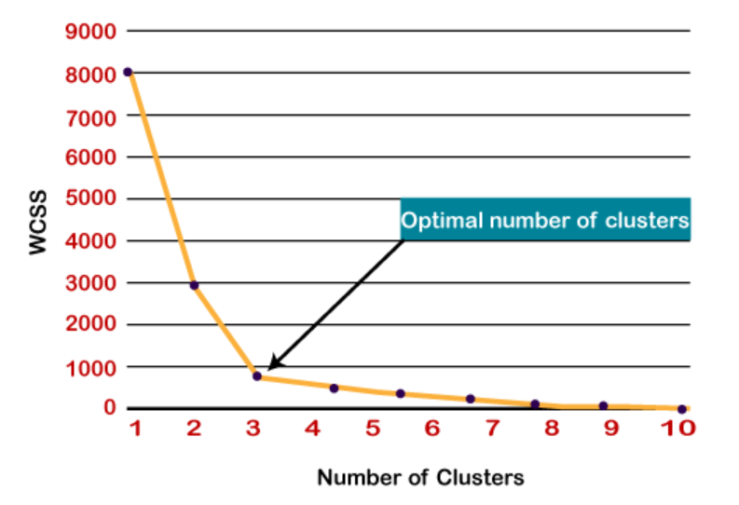
Elbow Method
The Elbow method is one of the most popular ways to find the optimal number of clusters. This method uses the concept of WCSS value. WCSS stands for Within Cluster Sum of Squares, which defines the total variations within a cluster

Slide 9
Python Implementation of K-means Clustering Algorithm
Let's understand what type of problem we will solve here. So, we have a dataset of Mall_Customers, which is the data of customers who visit the mall and spend there.
In the given dataset, we have Customer_Id, Gender, Age, Annual Income ($), and Spending Score (which is the calculated value of how much a customer has spent in the mall, the more the value, the more he has spent). From this dataset, we need to calculate some patterns, as it is an unsupervised method, so we don't know what to calculate exactly.
The steps to be followed for the implementation are given below:
Data Pre-processing
Finding the optimal number of clusters using the elbow method
Training the K-means algorithm on the training dataset
Visualizing the clusters

Slide 10
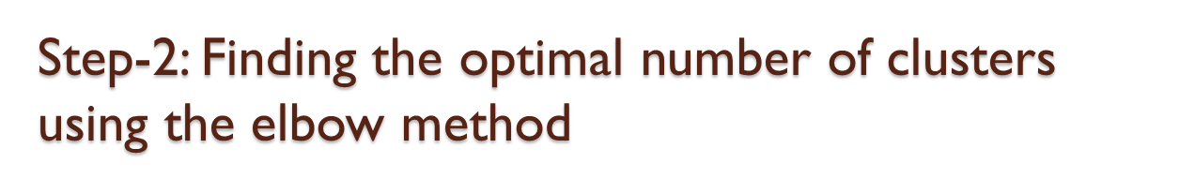
Step-1: Data pre-processing Step
# importing libraries
import numpy as nm
import matplotlib.pyplot as mtp
import pandas as pd
# Importing the dataset
dataset = pd.read_csv('Mall_Customers_data.csv')
# Extracting Independent Variables
x = dataset.iloc[:, [3, 4]].values
#finding optimal number of clusters using the elbow method
from sklearn.cluster import KMeans
list1 = [] #Initializing the list for the values of WCSS

Slide 11

#Using for loop for iterations from 1 to 10.
for i in range(1, 15):
kmeans = KMeans(n_clusters = i, init = 'k-means++', random_state = 42)
kmeans.fit(X)
list1.append(kmeans.inertia_)
plt.plot(range(1, 15), list1)
plt.title('The Elbow Method')
plt.xlabel('Number of clusters')
plt.ylabel('WCSS')
plt.show()
Step- 3: Training the K-means algorithm on the training dataset
#training the K-means model on a dataset
kmeans = KMeans(n_clusters = 5, init = 'k-means++', random_state = 42)
y_kmeans = kmeans.fit_predict(X)

Slide 12
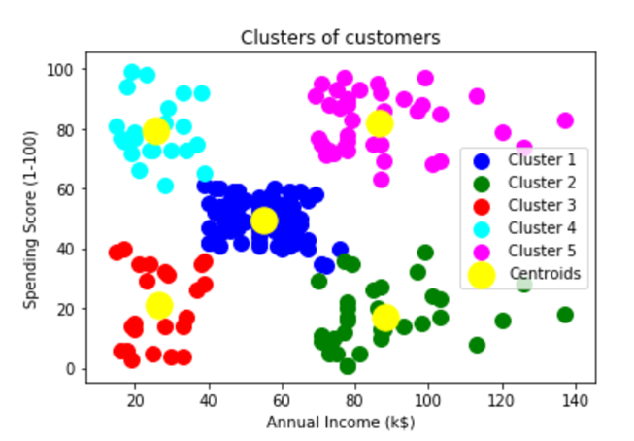
Step- 4: Visualizing the Clusters
#visulaizing the clusters
import seaborn as sns
facet = sns.lmplot(data=supervised, x=supervised.columns[3], y=supervised.columns[4], hue=supervised.columns[5],
fit_reg=False, legend=True, legend_out=True)

